Slide 1

About Me
I am Badal Kumar Jena, based out at Bangalore, India.
B-Tech in Computer Science Engineering.
11 years of experience in performing Secure SDLC activities like SAST, DAST, SCA, FOSS License Compliance, Vulnerability assessment, Risk Management and Software Design and Development.
I have joined XYZ on Jan 2014.
Certified Ethical Hacker.
Wildlife photographer

Slide 2
Agenda
Introduction to FOSS
FOSS Pros
& Cons
FOSS Licenses
Real-Time Scenarios
FOSS Consume
FOSS Create & Contribute
FOSS Policy
FOSS Strategy & Tools

Slide 3
What is FOSS ?
FREE
"Free and open-source software" (FOSS) is an umbrella term for software that is simultaneously considered both Free software and open-source software. FOSS (free and open-source software) allows the user to inspect the source code and provides a high level of control of the software's functions compared to proprietary software.
FOSS is software that is:
Available in source code form
Can be modified and redistributed without additional permission.
Although it comes with many freedoms, opensource software is licensed software.
While using the components in proprietary code, obligations of the licenses’ need to be followed.
OPEN
SOURCE
SOFTWARE
FOSS is based on an advocacy of copyleft concept to use, modify, redistribute and distribute the opensource component and releasing it back to the opensource community under the same license.
Notes:
Besides open source software, there are also other kinds of downloadable software that are not covered by the term "open source":
Shareware
Any software that may not be redistributed as part of another program.

Slide 4
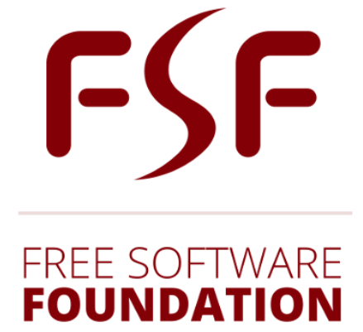
Free Software
Free Software: Richard Stallman's Free Software Definition, adopted by the Free Software Foundation (FSF), defines free software as a matter of liberty not price, and it upholds the Four Essential Freedoms (The GNU Project).
Four essential freedoms of Free Software
Freedom 0: The freedom to run the program as you wish, for any purpose.
Freedom 1: The freedom to study how the program works and change it so it does your computing as you wish.
Freedom 2: The freedom to redistribute copies so you can help others.
Freedom 3: The freedom to distribute copies of your modified versions to others

Slide 5

Open Source Software
A computer software with its source code made available with a license in which the copyright holder provides the rights to study, change, and distribute the software to anyone and for any purpose.
The OSI approved licenses are based on their Open Source Definition (OSD), which is mentioned below.
Free Redistribution
Source Code
Derived Works
Integrity of The Author's Source Code
No Discrimination Against Persons or Groups
No Discrimination Against Fields of Endeavor
Distribution of License
License Must Not Be Specific to a Product
License Must Not Restrict Other Software
License Must Be Technology-Neutral

Slide 6
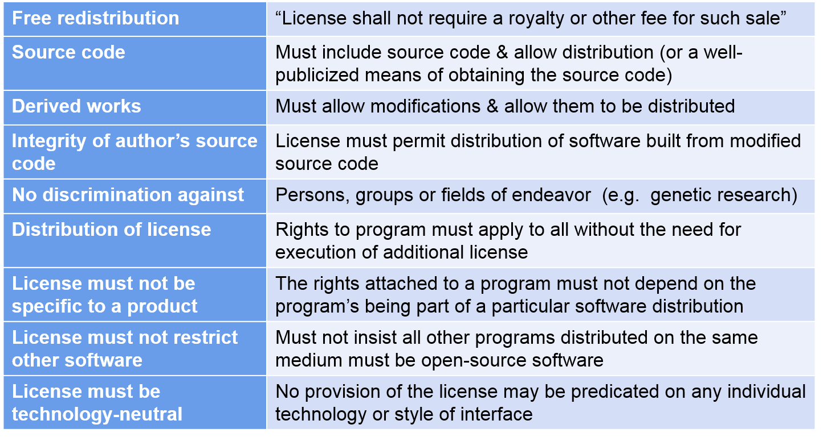
Open Source Definitions

Slide 7
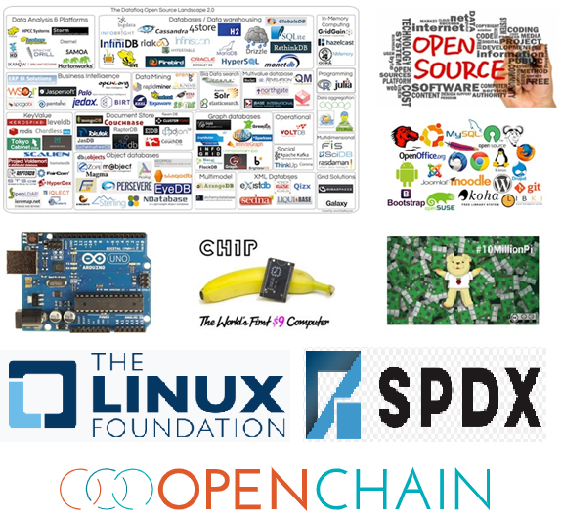
The Open Source Movement started in 1975 & still going strong!
March 5 1975: Homebrew Computer Club formed - Open exchange of computer ideas – launched personal computer revolution including Apple
Sep 27 1983 - Richard Stallman announced GNU Project for free Unix!
Oct 1985 – Free Software Foundation (FSF) formed.
1991 – Linus Trovalds creates Linux1
Feb 1998 – Bruce Perens and Eric S. Raymond founded Open Source Initiative (OSI)
2000 - SPDX by Linux Foundation.
2000 - The OpenChain project
2020 - SBOM by National Telecommunications and Information Administration (NTIA)
Last decade: More OSS projects Apache web server, Samba, GNOME, KDE, GIMP, MySQL, PostgreSQL, PHP, Mailman, XFree86, bind, GCC, Perl, Python, Mozilla, LibreOffice, GitHub, many

Slide 8
Advantages of FOSS
Time Savvy
Ready-made available
Cost-Effectiveness
Source code is available in free of cost to the end user
Open Standards
No restriction on using any standard practices
Performance
Fewer and Faster bug fixes.
Flexibility
Flexibility to use, copy, modify, merge, publish, distribute, etc
Strong Community
Strong Community helps in constant improvement.

Slide 9




Risks of using FOSS
Business
Risk
Usability
documentation
Support is not reliable
Operational
Risk
Security becomes major issue
Use of FOSS Licenses should be followed proper compliance process.
Proper usage documentation is not available
Support, bug fixes, maintenance to the project is not available
Inactive community, less commits, etc.
Finding of security vulnerabilities in projects

Slide 10
FOSS Licenses
Based on the conditions related to providing attributions, copyright statement preservation, usage, or a written offer to make the source code available under terms that allow for modification and redistribution, FOSS Licenses are categorized into 3 types.
FOSS License
Permissive
Weak Copyleft
Strong Copyleft

Slide 11
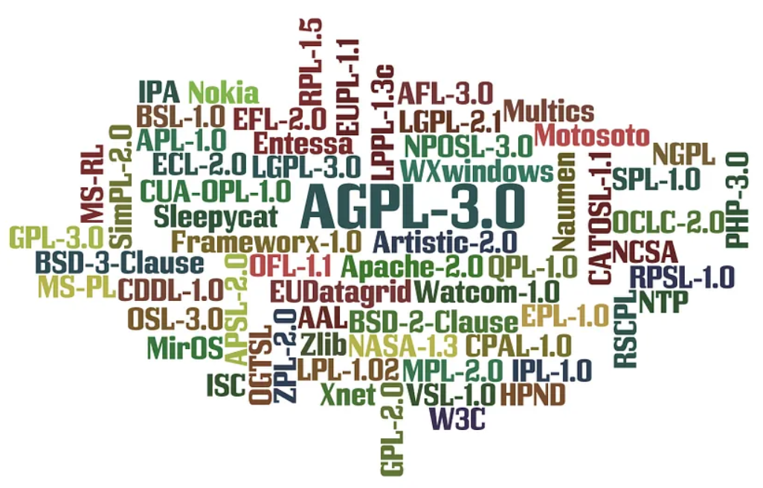
Continue…
Some examples of foss licenses are as follows.
MIT License
Apache License 2.0
ISC License
BSD 3-Clause “New” or “Revised” License
BSD 2-Clause “Simplified” License
Zlib/libpng License
Eclipse Distribution License – v 1.0
Common Development and Distribution License
Eclipse Public License 1.0
Mozilla Public License 2.0
Eclipse Public License 2.0
GNU General Public License v2.0 or later
GNU Lesser General Public License v2.1 or later
GNU General Public License v3.0 or later
GNU Lesser General Public License v3.0 or later
Affero General Public License v3.0 or later

Slide 12

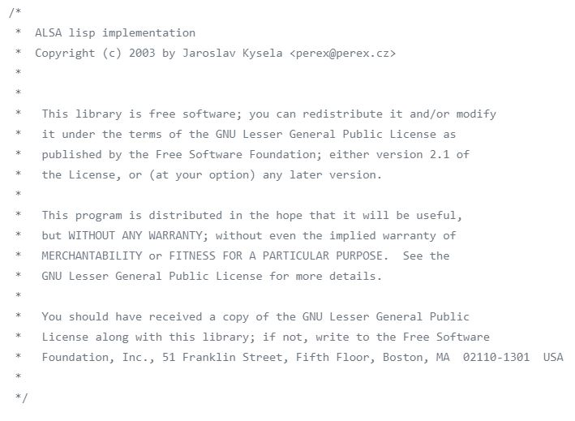
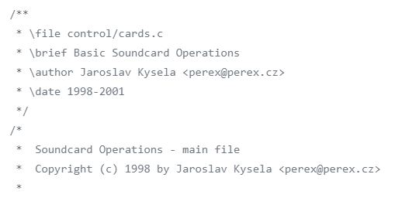
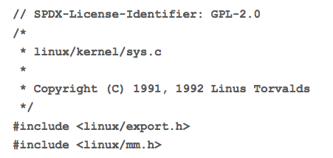
Copyright & Other Notice
Copyright is a legal form of protection given to the authors or creator of the original work of authorship including literary, dramatic, musical, artistic, and other intellectual works.
Additional information about the author, license and copyright information is captured in the notice file.

Slide 13
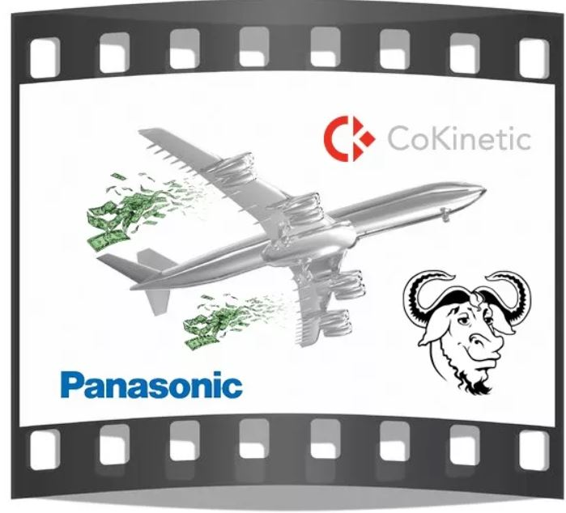
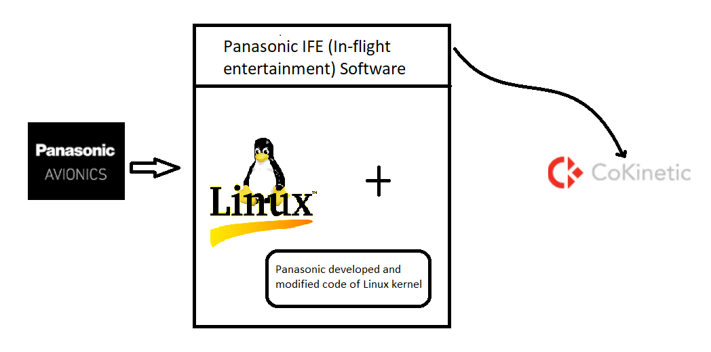
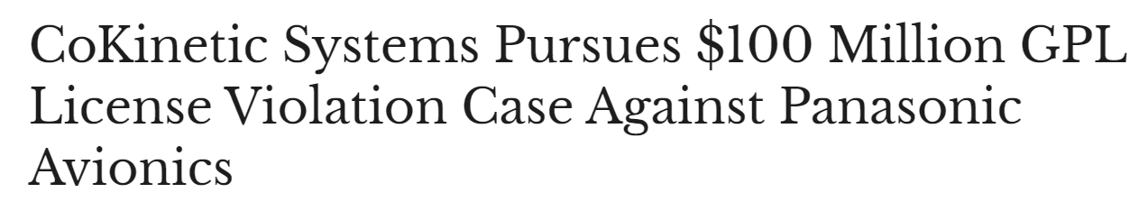
Legal Lawsuit – Panasonic Aviation vs CoKinetic Systems
CoKinetic Systems, a developer and manufacturer of in-flight entertainment (IFE) software, has filed a case against Panasonic Avionics that includes allegations of a fairly egregious breach of the GPL. The complaint alleges that Panasonic Avionics has monopolized the Panasonic IFE Software and Media Services Market by deliberately refusing to distribute the source code for its open-source Linux-based operating system.
Notes:
CoKinetic Systems, a developer and manufacturer of in-flight entertainment (IFE) software, has filed a case against Panasonic Avionics that includes allegations of a fairly egregious breach of the GPL. The complaint alleges that Panasonic Avionics has monopolized the Panasonic IFE Software and Media Services Market by deliberately refusing to distribute the source code for its open-source Linux-based operating system.
Panasonic has built the Linux-Based Panasonic Core Software using the open-source Linux kernel, which is clearly governed by the GPL, together with Panasonic’s own modified Linux modules, which are likewise governed by the GPL.
Panasonic has incorporated a massive amount of open source modules, programs, and libraries into the Linux-Based Panasonic Core Software, without distributing notices or source code to the Linux-Based Panasonic Core Software, or even to any part of it.
CoKinetic Systems contends that Panasonic’s refusal to distribute its source code voids its GPL license and “potentially exposes Panasonic to billions of dollars in statutory damages for hundreds of thousands of hardware installations that willfully infringe copyrights belonging to hundreds or even thousands of software developers that freely contributed source code to Linux.”

Slide 14
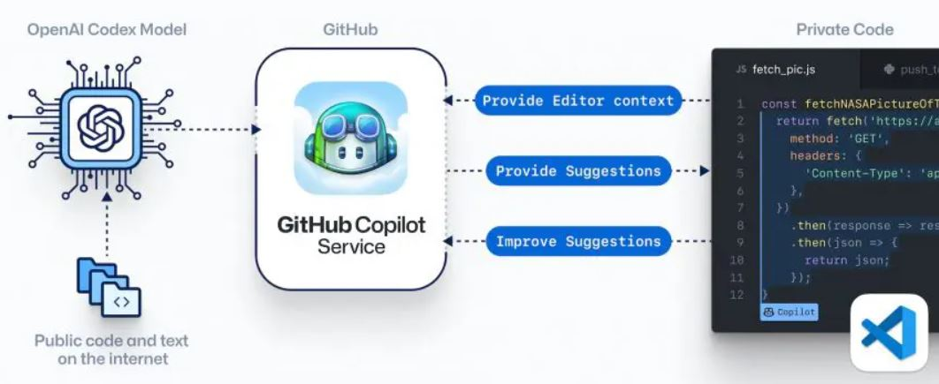
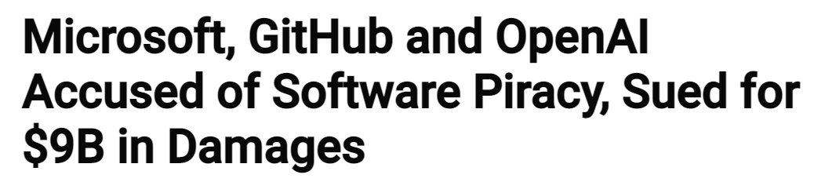
Legal Lawsuit – Microsoft GitHub Copilot
Joseph Saveri Law Firm filed a law­suit chal­leng­ing GitHub Copi­lot, an AI prod­uct that relies on unprece­dented open-source soft­ware piracy.
It violates OSS licensing attributes and limitation.
Not only it violates GitHub ‘s terms & conditions of service and privacy policies it also violates DMCA 1202, which forbids the removal of copyright management information.
Notes:
While Copilot can speed up the process of writing code and ease software development, its use of public open-source code has caused experts to worry that it violates licensing attributions and limitations.
Open-source licenses, like the GPL, Apache, and MIT licenses, require attribution of the author's name and defining particular copyrights.
However, Copilot is removing this component, and even when the snippets are longer than 150 characters and taken directly from the training set, no attribution is given.
Some programmers have gone as far as to call this open-source laundering, and the legal implications of this approach were demonstrated after the launch of the AI tool.
Apart from the license violations, there is alleges that the development feature violates the following:
GitHub's terms of service and privacy policies,
DMCA 1202, which forbids the removal of copyright-management information,
the California Consumer Privacy Act,
and other laws giving rise to the related legal claims.

Slide 15

Benefits of FOSS Compliance and Governance
Enhance our understanding of the benefits of Open Source and its impact on our organization.
Facilitate the effective usage of Open Source in our products.
Increase awareness of the costs and risks associated with using Open Source.
Expand knowledge of the available Open Source solutions.
Reduce and manage infringement risk while respecting the licensing choices of Open Source developers/owners.
Foster relationships with the Open Source community and organizations.

